Slide 1


How this internship benefit my life
Pannathorn Naksung
Under Personal Assurance Claim Division
2018/06/04-2018/07/26

Slide 2
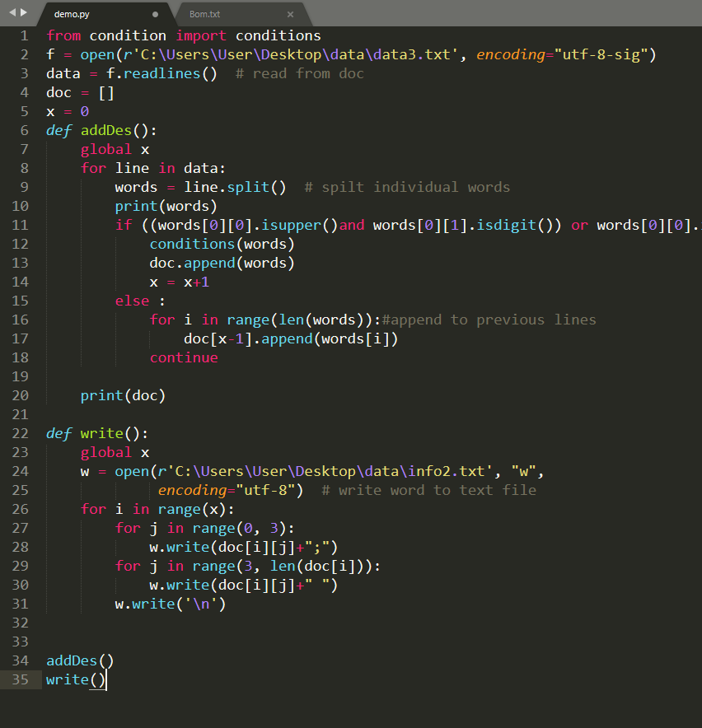
What have I done
Convert 20,000 ICD* Medical code into Excel.
Excel macro to check the accuracy between 2 reports.
Excel macro to check accuracy of the report.
Help to write a part of Auto Matching Project.
*ICD(International Classification of diseases )

Slide 3

Technical Skills
Critical Thinking
Creative Thinking
Proficient in programming language

Slide 4

Soft Skills
Work Ethic
Presentation
Communication

